Slide 1




Fetal Health Diagnostics: A Multivariate Approach
BIOS 511: Healthcare Data Science
Final Presentation
Team:
Ajay Sreekumar
Jasdeep Singh Jhajj
Mohit Rakesh Taparia
Riyanshi Bohra
Shashwat Singh

Slide 2






Agenda
Overview
Literature
Review
Data
Description
Data
Analysis
Model
Development
Results

Slide 3


Our Main Focus
How can automated analysis of cardiotocogram data help predict fetal health outcomes and reduce fetal and maternal mortality?
Why?
A global challenge: tackling preventable child and maternal mortality.
In alignment with UN Sustainable Development Goals: Good health and well-being.
Leveraging CTGs: Accessible, cost-effective fetal health monitoring.
1

Slide 4


Literature Review
Detection of Preventable Fetal Distress During Labor from Scanned Cardiotocogram Tracings Using Deep Learning
by Martin G. Frasch et al. (2021).
Objective: To develop a deep learning model that detects early fetal distress using 50 years of CTG data.
Methodology:
• Data: 50 years of electronic fetal monitoring (EFM) tracings.
• Approach: Analyze fetal heart rate (FHR) and uterine contractions using a convolutional neural network.
• Process: Digitized CTG tracings fed into a deep learning pipeline for real-time analysis.
Findings:
• Achieved 94% accuracy in detecting early signs of fetal distress.
• Identified preventable injuries with precision.
• Bridged historical medical data with cutting-edge AI.
2

Slide 5
Literature Review
01
02
03
Spilka, J et al. (2022)
Georgieva et al. (2013)
Reddy et al. (2023)
Dataset: 634 CTG recordings by nine obstetricians
Methods: Decision trees, SVMs, neural networks. Used precision, recall, and F1 score for classification evaluation.
Findings: SVM achieved the best accuracy. Key features: baseline fetal heart rate, variability, and acceleration.
Relevance: Demonstrates the utility of ML models for real-time monitoring and diagnosis of fetal health.
Dataset: 2,000+ CTG records from a multicenter study.
Methods: Developed a CNN to classify CTG patterns
Findings: CNN outperformed traditional algorithms & addressed challenges like noisy signals and imbalanced data through advanced preprocessing.
Relevance: Highlights key features like decelerations for fetal health classification.
Dataset: 2,126 CTG records.
Methods: Random Forest, Decision Tree, AdaBoost.
Findings: RF and AdaBoost classifiers demonstrated higher performance compared to DTC. Severe and prolonged decelerations were linked to abnormal fetal health states, highlighting their significance in classification tasks
Relevance: Highlights potential of deep learning approaches fetal health diagnostics.
3

Slide 6



Data Sources
Where did the data come from?
Data Origin:
The dataset was sourced from cardiotocograms (CTGs) performed during pregnancy as described in the study by Ayres-de-Campos et al. (2000).
Collection Process:
CTGs were generated using ultrasound sensors to record fetal heart rate (FHR), uterine contractions, and accelerations.
The data was reviewed and labeled by expert obstetricians into three categories: Normal, Suspect, and Pathological.
4

Slide 7
Variable Description
Understanding the variables
Response Variable:
The target variable, fetal_health, is categorized into three classes:
Normal (1), Suspect (2), and Pathological (3), based on obstetrician diagnosis.
Key Features:
- Baseline Value: Average fetal heart rate; a core metric for assessing fetal well-being.
- Accelerations: Indicate fetal activity and well-being.
- Variability Metrics: Measure fluctuations in FHR, critical for assessing oxygenation.
- Histogram Metrics: Provide statistical context to FHR distribution.
- Uterine Contractions: Frequency and intensity of maternal uterine contractions during labor.
- Prolonged Decelerations: Decreases in fetal heart rate below the baseline, lasting more than 2 mins.
5

Slide 8

Confounding Variables & Impact
Potential Factors:
1. Uterine Contractions:
Impact: Directly influences fetal heart rate variability and decelerations.
2. Maternal Health Factors:
Examples: Gestational diabetes, hypertension, maternal age
3. Measurement Noise:
From sensors used during CTG recordings.
Impact: May introduce variability unrelated to actual fetal health.
Factors like uterine contractions and variability metrics are strongly correlated, potentially masking the independent impact of key features like accelerations.
Although maternal health data is absent, accounting for interactions between features minimizes noise.
6

Slide 9
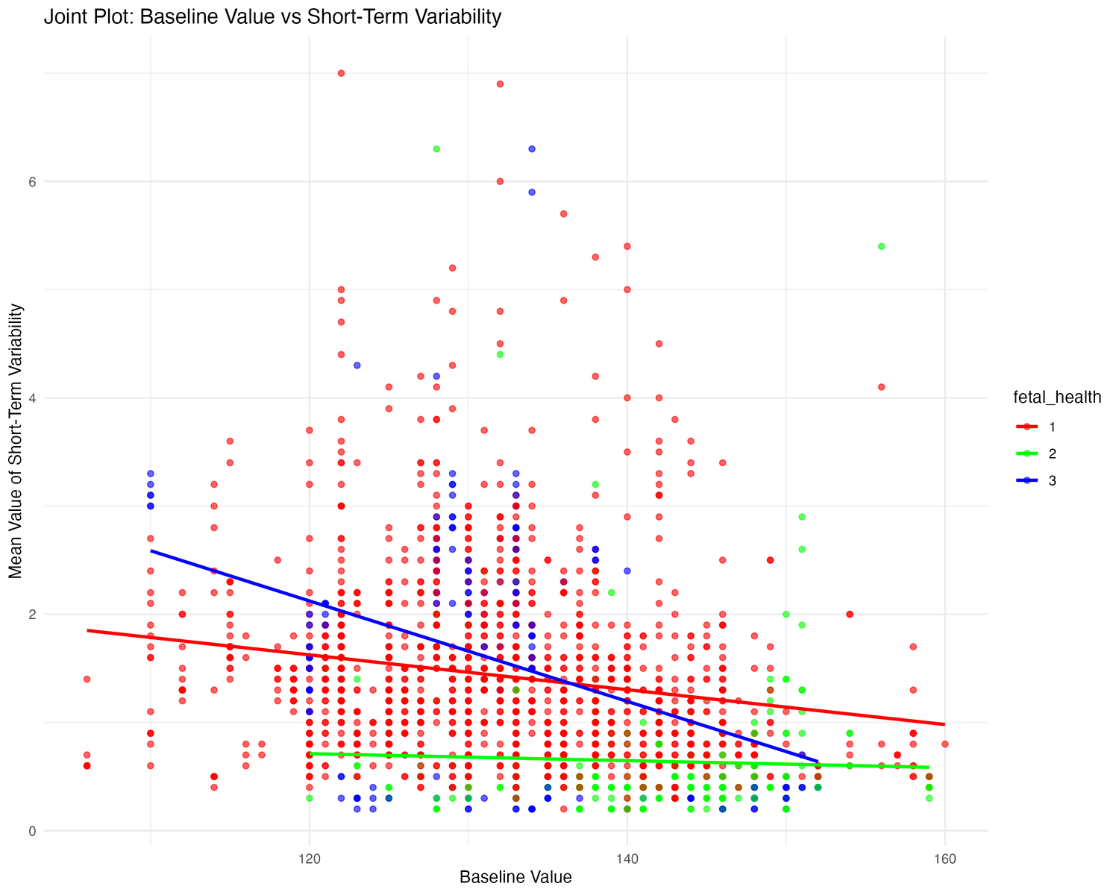
Exploratory Data Analysis
This plot highlights the relationship between Baseline Fetal Heart Rate (FHR) and Short-Term Variability.
To assess how these relationships differ among fetal health categories: Normal, Suspect, and Pathological.
Visual Elements of the Plot:
Scatter Plot: Each point represents an observation, color-coded by fetal health status.
Trend Lines: Linear model fits for each health category, highlighting the trend without the distraction of confidence intervals.
The data points are color-coded based on fetal health classes:
Red (Class 1 - Normal),
Green (Class 2 - Suspect),
Blue (Class 3 - Pathological).
Key Insights:
A negative correlation is evident for Class 1 (Normal) and Class 3 (Pathological), indicating that as Baseline FHR increases, Short-Term Variability decreases.
Class 3 (Pathological) shows significantly lower baseline values compared to Class 1 and Class 2.
This highlights how Baseline FHR and Short-Term Variability are critical features for differentiating fetal health categories.
7

Slide 10
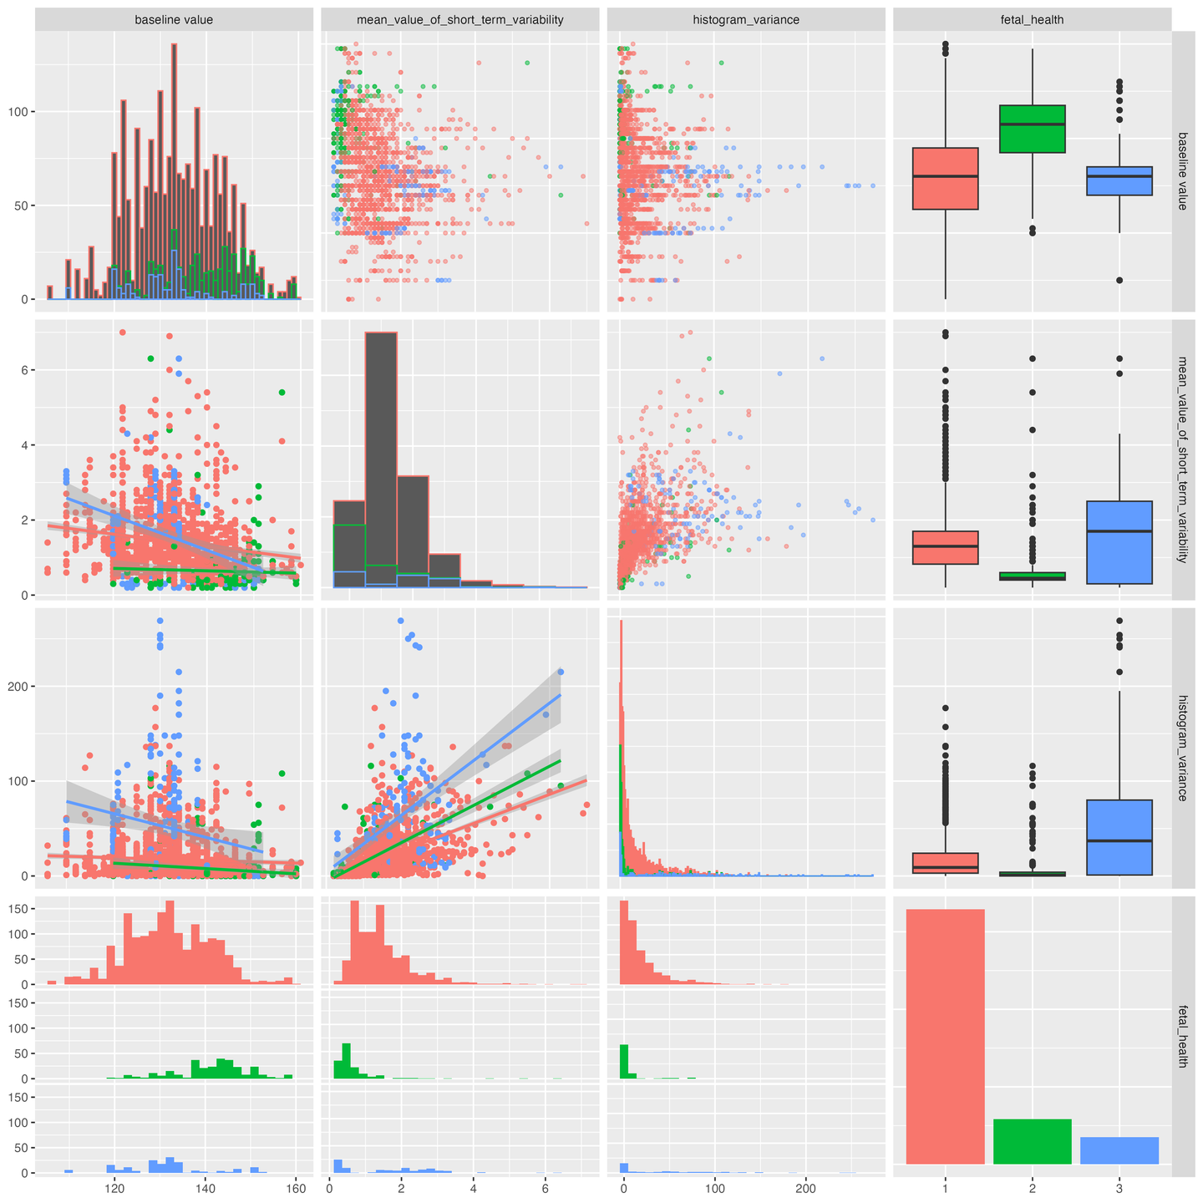
Exploratory Data Analysis
This plot visualizes pairwise relationships between key features like Baseline Value, Short-Term Variability, Histogram Variance, and Fetal Health Class
Key Observations:
Baseline Value Distribution:
Class 1 (Normal) has a wider and higher distribution of Baseline FHR.
Class 3 (Pathological) is clustered toward lower baseline values.
Box Plots:
Variance in Histogram Variance and Short-Term Variability is significantly higher for Class 3, suggesting instability in FHR for pathological cases.
Histograms:
The imbalance in class distribution is clearly visualized, with Class 1 dominating the dataset.
Correlation Insights:
Features like Baseline Value and Histogram Variance show non-linear relationships across classes, further reinforcing the need for non-linear classifiers (e.g., Gradient Boosting and XGBoost).
8

Slide 11
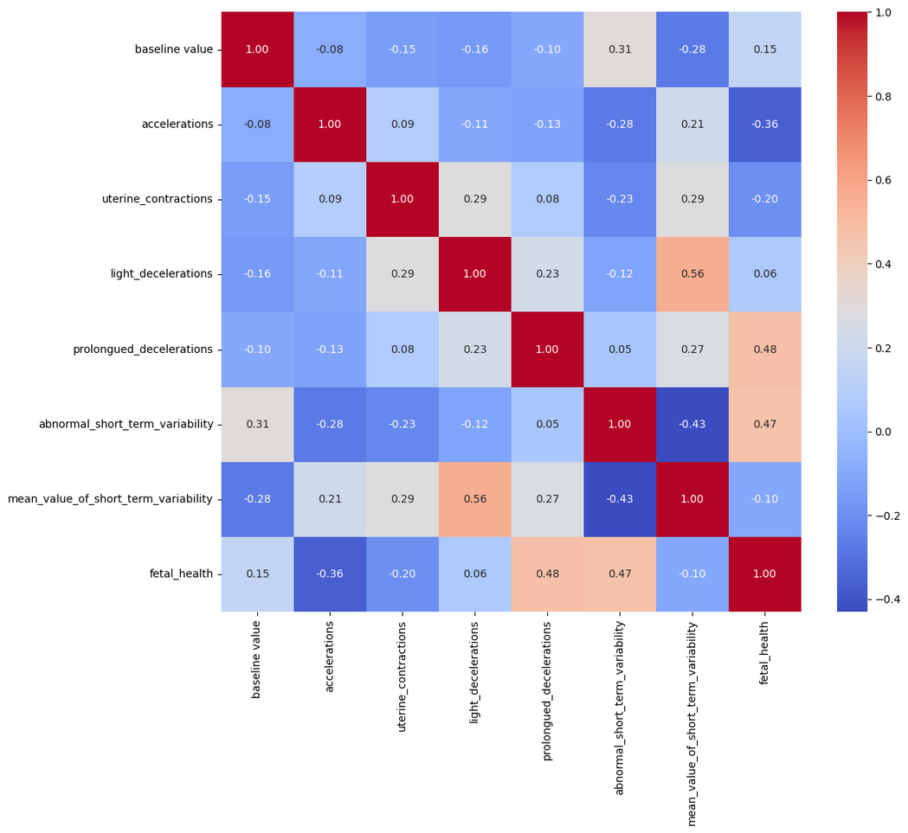
Exploratory Data Analysis
The heatmap visualizes pairwise correlations among features and their relationship with the target variable (Fetal Health).
Key Observations:
Strong Correlations:
Baseline Value shows moderate positive correlation with Fetal Health (0.15).
Prolonged Decelerations and Abnormal Short-Term Variability have strong correlations with Fetal Health, indicating their critical role in classification.
2. Feature Interdependence: Mean Value of Short-Term Variability is positively correlated with Light Decelerations (0.56), suggesting shared variability.
9

Slide 12
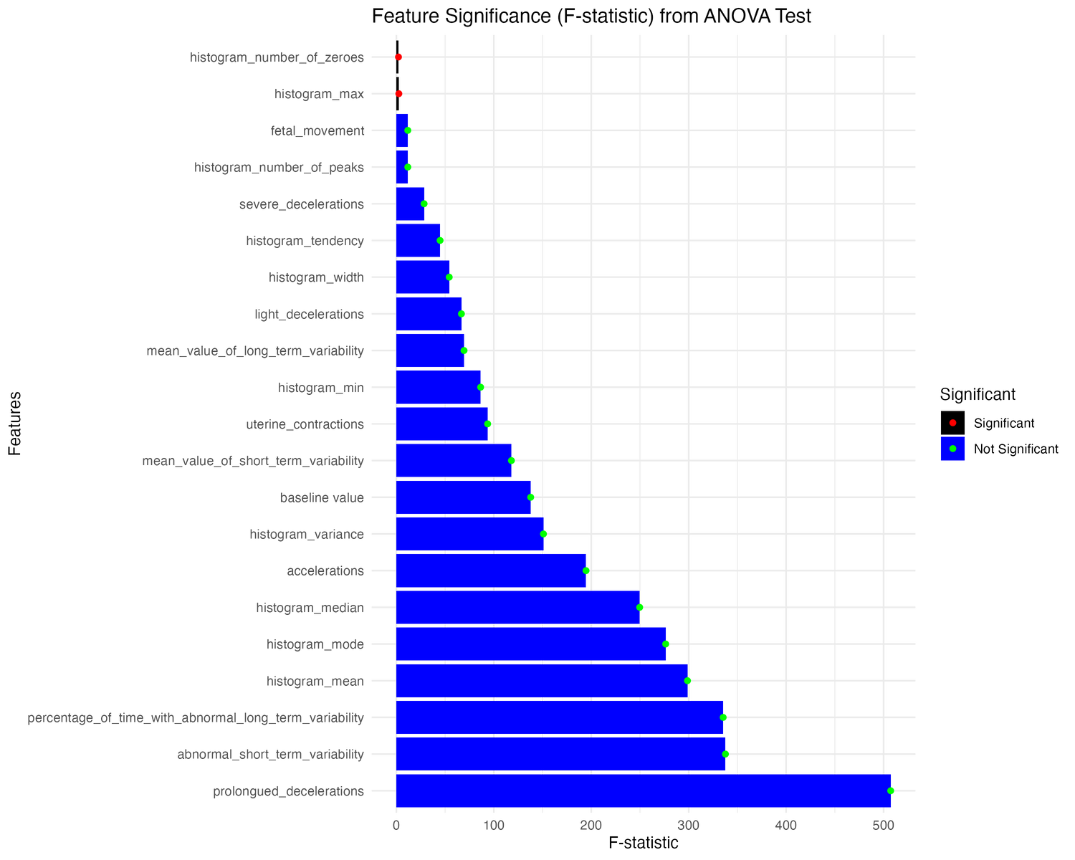
Exploratory Data Analysis
Examine the impact of various physiological and monitoring features on fetal health using ANOVA (Analysis of Variance) F-statistics.
Methodology:
Conducted ANOVA tests for each feature against fetal health categories.
Assessed the statistical significance and strength of associations through F-statistics.
Features are grouped as Significant (red markers) or Not Significant (blue markers) based on their contribution to fetal health classification.
Key Findings:
Highly Significant Features: Prolonged Decelerations, Abnormal Short-Term Variability, and Percentage of Time with Abnormal Long-Term Variability have the highest F-statistics, making them the most significant predictors of fetal health.
Features with Lower Impact: Histogram number of zeroes, histogram max, and fetal movement.
Insights:
Focus on the top-ranked features can lead to better model performance and interpretability.
10

Slide 13
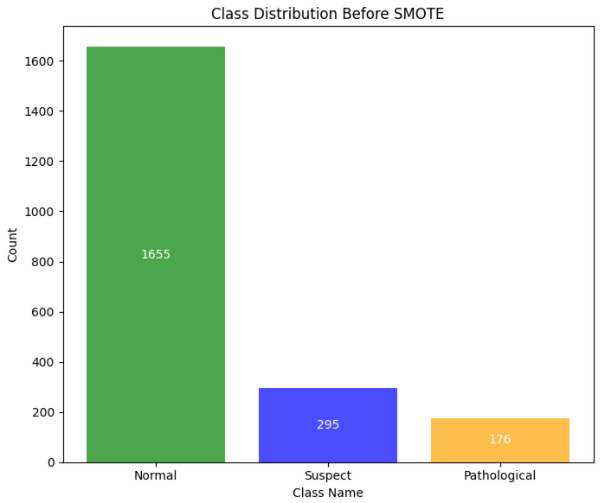
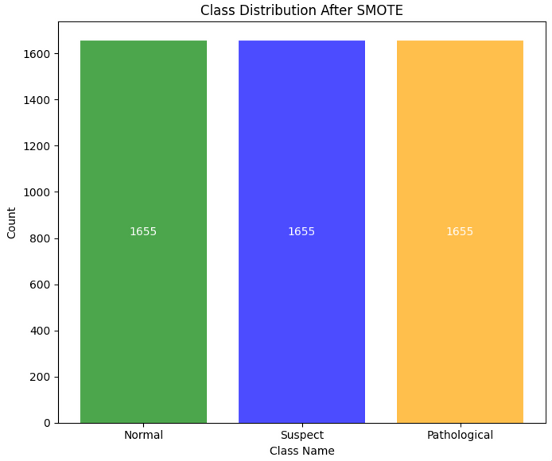
Data Handling
Dataset Issue: Class Imbalance
Approach: SMOTE (Synthetic Minority Oversampling Technique)
The fetal_health classes are highly imbalanced, with the majority of samples labeled as Normal. This was addressed using SMOTE to generate synthetic samples for minority classes (Suspect and Pathological).
11

Slide 14
Data Handling
Dataset Issue: Class Imbalance
Approach: Cross Validation (RandomizedSearchCV)
RandomizedSearchCV:
Efficient hyperparameter optimization technique used to identify the best parameters for each model while minimizing computation time.
Key hyperparameters tuned:
Logistic Regression: solver, penalty, C.
Random Forest: n_estimators, min_samples_split, min_samples_leaf, max_depth.
Gradient Boosting & XGBoost: n_estimators, max_depth, learning_rate.
12

Slide 15
Model Development
Model Selection:
We evaluated a variety of machine learning models to identify the best-performing algorithm for predicting fetal health
1. Logistic Regression: A baseline model that uses a linear approach to predict class probabilities.
Provides an interpretable and efficient way to evaluate relationships between features and outcomes.
2. Random Forest Classifier: An ensemble learning method that constructs multiple decision trees and combines their outputs for classification.
Handles imbalanced data well and provides insights into feature importance.
3. Gradient Boosting: A boosting technique that sequentially builds models to minimize prediction errors by focusing on misclassified cases.
Effective for capturing complex patterns in the data.
4. XGBoost: An optimized implementation of gradient boosting designed for speed and performance in large datasets.
Offers robust handling of feature interactions and reduces overfitting.
13

Slide 16
Accuracy Assessment
Before SMOTE
Accuracy
Precision
Recall
F-1 Score
Logistic
Regression
0.875
0.866
0.875
0.866
Random
Forest
0.927
0.924
0.927
0.923
Gradient
Boosting
0.935
0.936
0.935
0.936
XGBoost
0.929
0.927
0.929
0.927
15

Slide 17
Accuracy Assessment
After SMOTE
Accuracy
Precision
Recall
F-1 Score
Logistic
Regression
0.849
0.851
0.849
0.849
Random
Forest
0.978
0.979
0.978
0.978
Gradient
Boosting
0.981
0.98
0.981
0.98
XGBoost
0.983
0.984
0.983
0.984
16

Slide 18
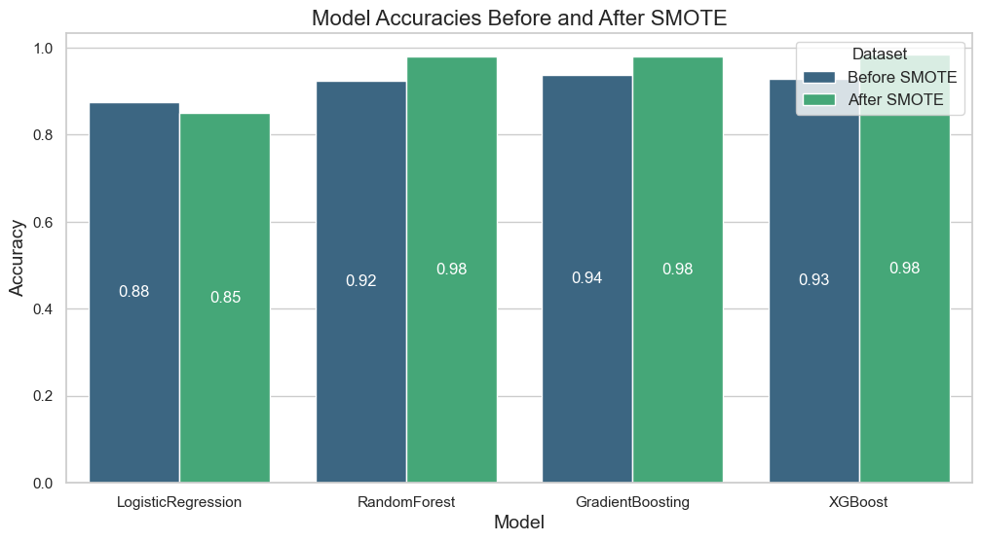
Results
Performance Highlights:
Superior Model Performance:
Gradient Boosting, XGBoost and Random Forest models achieved the highest accuracy (98%), showcasing their ability to handle complex, non-linear relationships within the dataset.
These models effectively captured non-linear patterns in the dataset, addressing the complexity of fetal health classification.
Logistic Regression:
Served as a baseline model with moderate performance (85% accuracy), providing a linear perspective on feature contributions.
17

Slide 19
Results
General Observations:
Overfitting Mitigation:
To address potential overfitting due to the small dataset size, a 5-fold cross-validation was used, ensuring robust evaluation across all models.
Dataset-Specific Challenges:
High accuracy values may reflect the smaller dataset's limited variability. However, SMOTE balanced the dataset effectively, allowing minority class patterns to emerge.
Public Health Significance:
For public health data, prioritizing high accuracy reduces critical false negatives, enabling safer decision-making for fetal health interventions.
Quantitative Performance Summary:
Trade-offs:
XGBoost offered marginally better precision, while Gradient Boosting demonstrated a slight edge in recall and F1-Score, emphasizing its suitability for imbalanced classes.
18

Slide 20



Conclusion
Impact: This approach demonstrates the potential of CTG analysis in reducing preventable fetal distress and improving maternal-fetal outcomes.
Why it matters?
What we discovered?
The bigger picture
Fetal distress contributes to neonatal and maternal complications worldwide. CTG analysis offers a cost-effective, non-invasive solution to address these critical challenges.
Our project achieved high accuracy in classifying fetal health. These findings validate the clinical importance of using machine learning for CTG analysis.
AI-driven solutions bridge the gap between technology and accessible healthcare. This work highlights the potential for scalable applications in global maternal-fetal health systems.
19

Slide 21


Thank you!
Presentation By:
Ajay Sreekumar
Jasdeep Singh Jhajj
Mohit Rakesh Taparia
Riyanshi Bohra
Shashwat Singh

